Slide 1

League of Legends Winning Prediction
Jingyao Yang

Slide 2
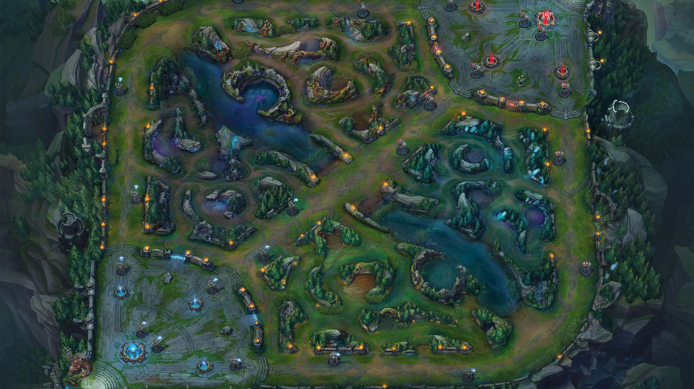
1. League of Legends is a 5v5 online competition game 2. The victory condition is to destroy the enemy’s nexus
Background introduction

Slide 3

Analysis Questions
1. Analyze some characteristics of champions, including common combinations
2. According to the various situations of both teams, predict the result of the game.

Slide 4
Data
1. There are 51490 rows and 61 columns in the dataset
2. 61 features can be summarized into 5 categories based on the characteristics of the League of Legends
Feature of champion's picks for each team
Feature of champion’s bans for each team
Feature of summoner spells
Feature of first kills about all the important elements
Feature of objects been destroyed by each teams

Slide 5

Method
Logistic Regression
Logistic Regression is the best method for the binary classification question which only return True and False

Slide 6
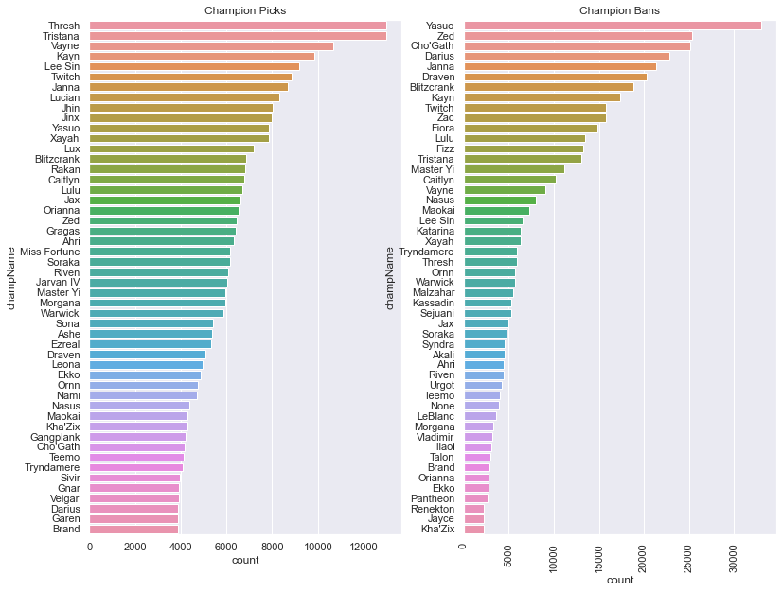
Visualization
Champions Picks & Bans

Slide 7
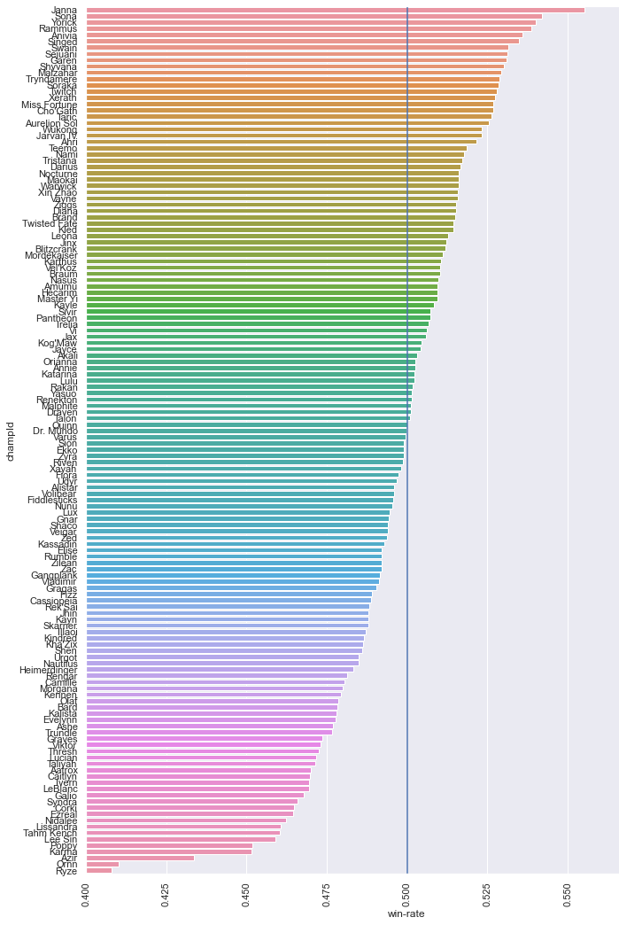
Single Champion Win Rate

Slide 8
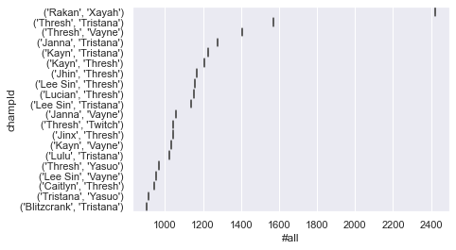
Champions Picks In Same Team

Slide 9
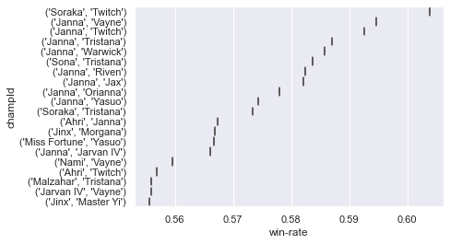
Win Rate For Champions Combinations

Slide 10
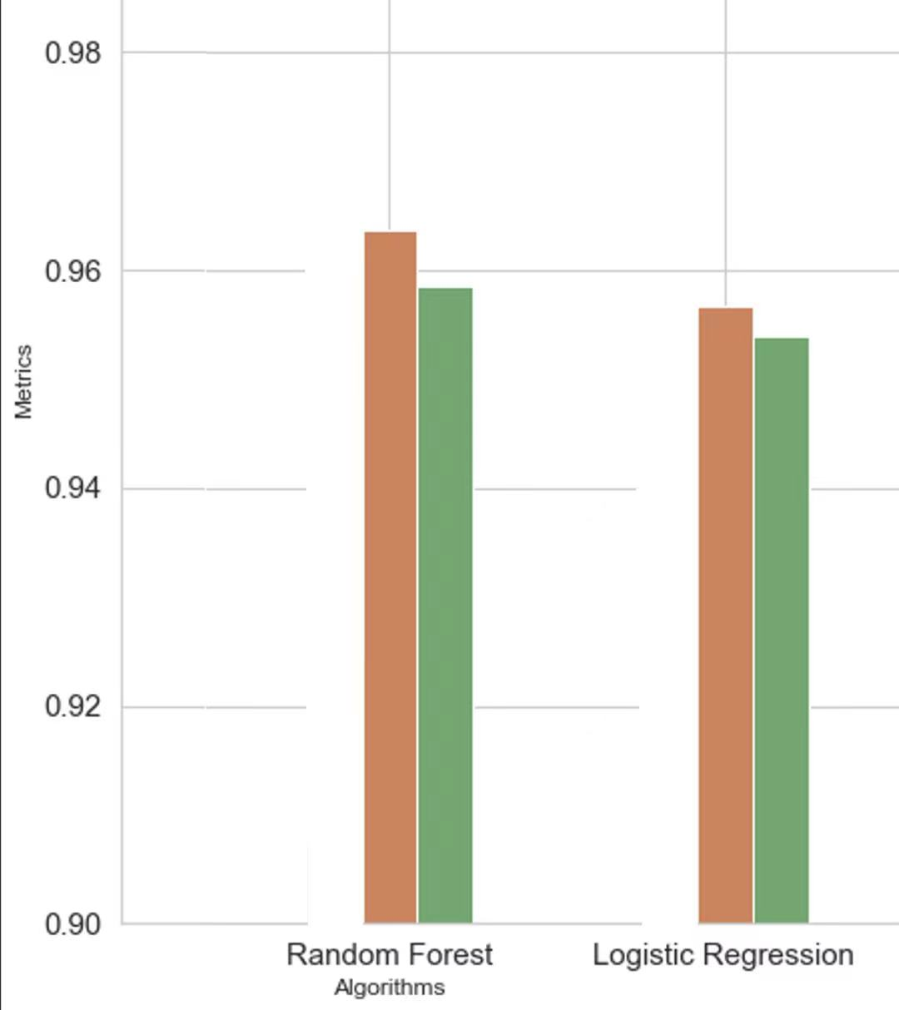
Metrics
Accuracy: (TP+TN)/(TP+TN+FP+FN)
Precision: (TP)/(TP+FP)

Slide 11


Insight
1. Players like to pick the champions which have better performance at early game instead of have better performance on win rate.
2. The most helpful features are “Total turrets destroyed” and “First turrets destroyed”

Slide 12

Thank You

